Slide 1
Javascript useful console methods()
{
Part (2)
}
...

Slide 2
Table of contents
01
02
03
Error method()
Assert method()
03
Group method()
04
Table method()

Slide 3
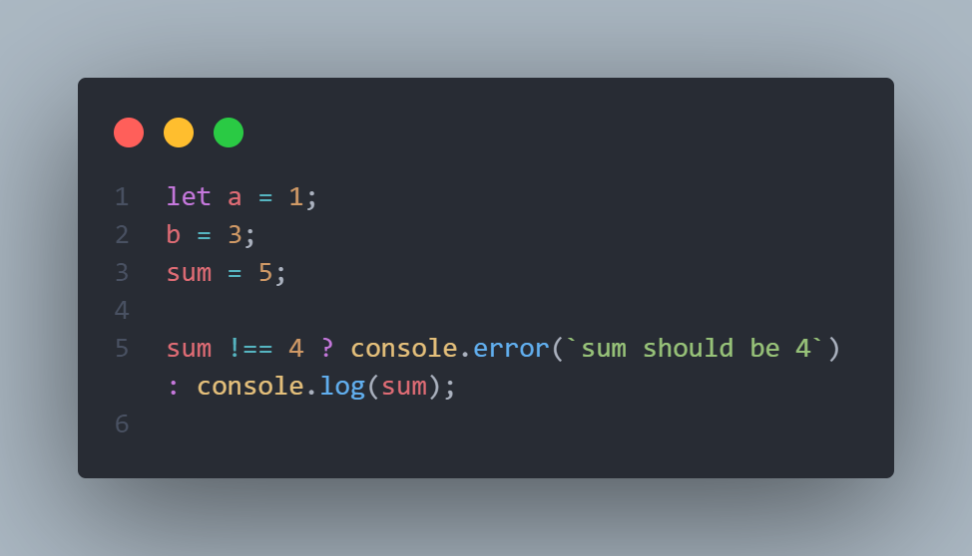
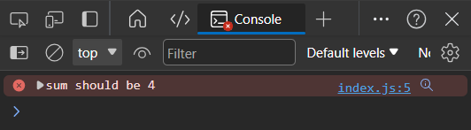
Error method()
{
In JavaScript, console.error() is a method used to log error messages to the console. The console object is part of the browser's debugging tools and provides methods for logging information, warnings, and errors. The console.error() method specifically is used to output error messages to the console, and it is typically formatted in a way that makes it stand out from regular log messages.
Output :
}
...

Slide 4
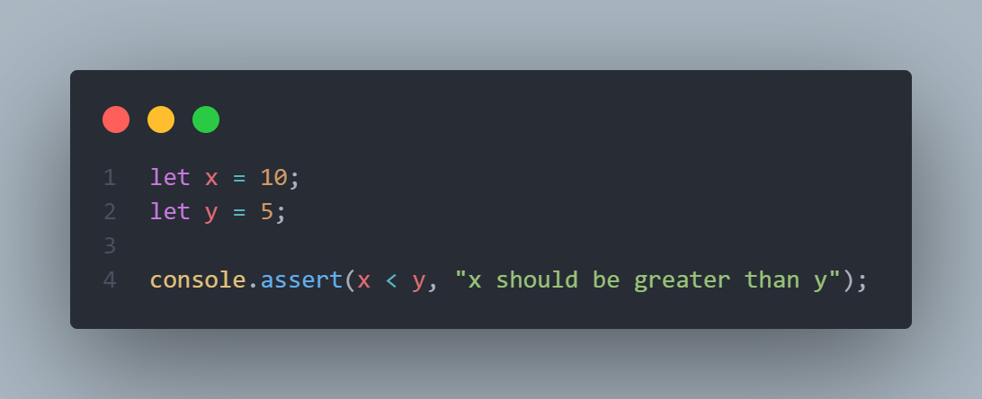
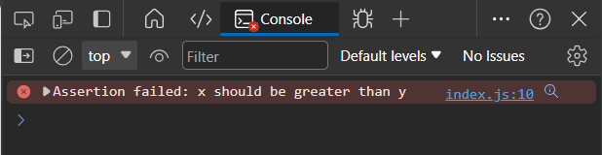
Assert method()
{
The console.assert() method is another function provided by the console object in JavaScript, and it is used for debugging purposes. This method takes an expression as its first argument, and if the expression evaluates to false, it logs an error message to the console.
Output :
}
...

Slide 5
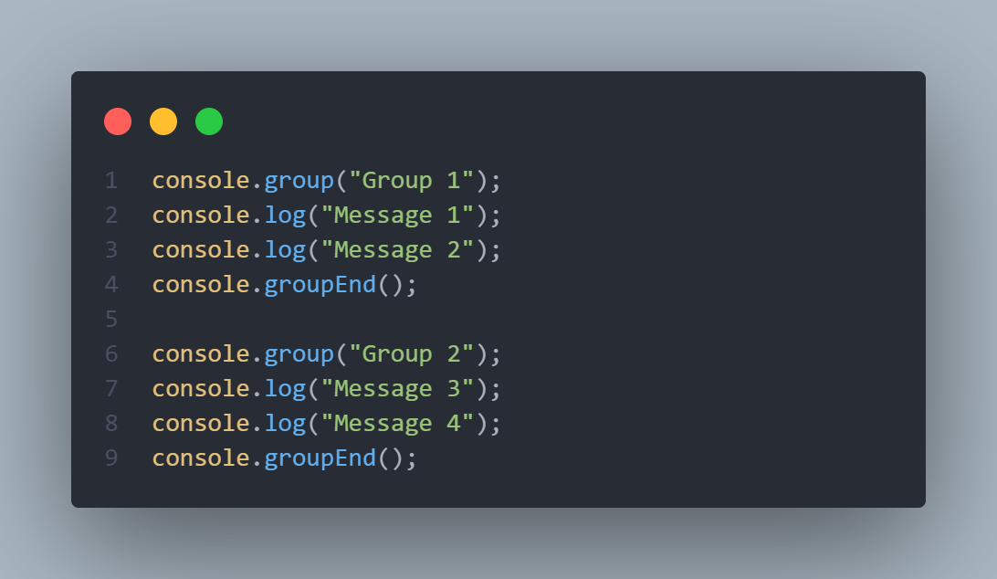
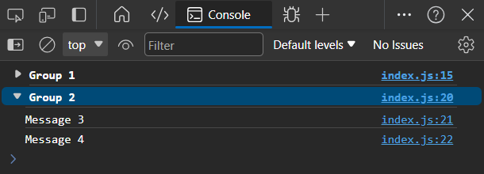
Group method()
{
console.group() method in JavaScript, it is used to group together related log messages in the console, providing a more organized and structured output. This is often helpful when dealing with complex code or debugging large applications.
Output :
}
...

Slide 6
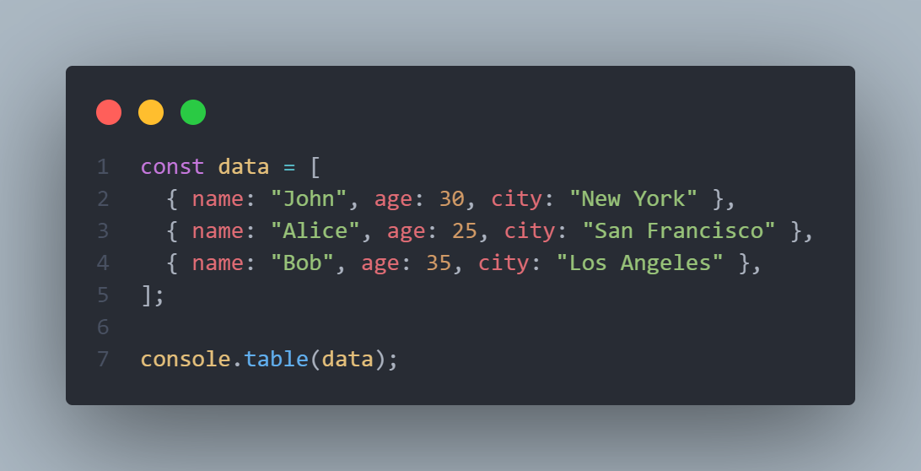
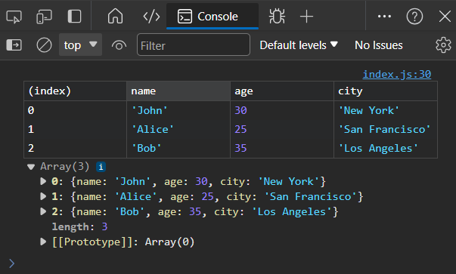
Table method()
{
The console.table() method in JavaScript is used to display tabular data in a tabular format within the console. It is particularly useful for visualizing arrays or objects with structured data. When you pass an array or an object to console.table(), it presents the data in a table, making it easier to interpret.
Output :
}
...

Slide 7

{
*
..
Abdelrahman hassan
Front-end (React) Developer
}
..

Slide 8





Thanks!
< Do you have any questions? >

